Slide 1
An Instance of Fair IDN Service, Korean Experience
Young S. Han
COCif, Hangul IDN Community

Slide 2
Statement Internet Linguistic Rights
Proposition 1:
A community holds the rights to make linguistic decisions over its language.
Proposition 2:
Internet names and Top-Level-Domains are results of linguistic activities.
Proposition 3:
Linguistic activities by a language community are not to be restricted by its population or market sizes.

Slide 3
Naming is Linguistics Cyber Lexicon(CL)
Naming associates Resources with Vocabularies
It is a Means to spread resources and build knowledge
“Naming on line is just another linguistic behavior”
Civilization
Information/Knowledge
Domain Names –
Cyber Lexicals
Traditional Vocabulary

Slide 4
General Naming Framework (GNF)
Naming Scheme as a reference method of Everything
Membership . Concept
Contents
PAGES
SITES
Referents
Objects
Commands (Functors)

Slide 5
HANGUL IDN, history
Dial Address Service (Command Address)
“.한국” ICANN IDN ccTLD
COCif – Noncommercial Agent to regulate
Hangul IDN in Korea – 197 local
governments seeking own TLDs
2009 Over 400 TLDs and 30K Units registered
2007 90% Access Coverage in Korea
2004 Hangul Root Server with Korea Telecom
2000 The Hangul (script used in Korea) IDN began as a Content Address

Slide 6
Status of HANGUL IDN @ Korea
First Content Address (to map content referents)
First Function Address (to replace phone numbers)
600 gTLDs under operation
Cities, Contents categories, Community names, Company/Brand names
First Non commercial Agency for Alternative Root
About 1M queries/day for HANGUL addresses
소녀시대.음악 (girlsgeneration.music)
Page Access
Phone Call
스마트폰.삼성 (smartphone.samsung)
시청.서울 (cityhall.seoul)

Slide 7
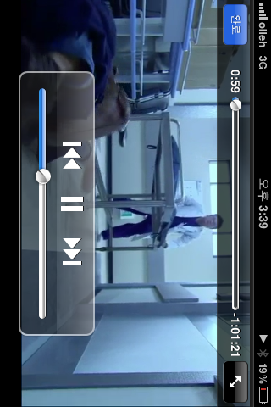
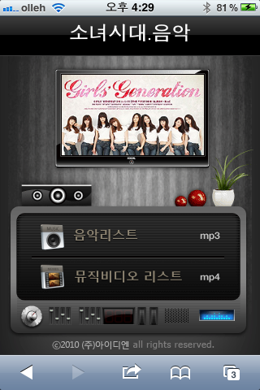
소녀시대.음악 girlsgeneration.music
Means to spread Contents Accurately

Slide 8
New gTLD by ICANN
Is to leave from “vacant” TLDs such as “.com” and “.net”
To Concept TLDs
More Accurate and Concrete Addresses
This is a different issue from accepting IDNs

Slide 9
Problems with Unilateral System of IDN Administration by ICANN
Penalization of Hangul script
1. Opportunity for new gTLDs is not the same
Only few Hangul gTLDs will be able to get access to ICANN ROOT
Due to high application price and complex procedure
2. Linguistic process is disrupted
Language community has all rights to continue their own linguistic
Behaviors with online vocabularies. ( creating, modifying )
What if “.왕” (.king) cannot be used in Hangul users, because “.wang”
is claimed by someone else with a bigger market.

Slide 10
Notion of IDN Fairness
Fairness is accepted only when
Results in the same number of Hangul gTLDs.
As ASCII gTLDs
Offline linguistic process is equally preserved in
Online linguistics for the people of the script.

Slide 11
For FAIR IDN
ICANN’s new equation is not just.
New_gTLD = Open_TLD + IDN
Rather, New_gTLD = Open_TLD x IDN
Realization that Naming is linguistics.
Scripts are not to be valued by Market size
TLD candidates are to be valued in script users’ context, not in global scope.

Slide 12
Sum of Localized Administrations
Unified Sum of Local Policies for gTLDs
TLD Decisions/Registry Selection by Language Communities
Global Arrangement by ICANN
One Globe
ASCII
Hangul
No one set of rules, but One network of rules

Slide 13
Thanks
TCP/IP and IP addresses may be fine in an unified set of rules
But languages are not to be unified.

